Slide 1
Accelerated Ray Tracing
Using BVH Tree and CUDA
Final Project – ECS275A
Ahmed H.Mahmoud
EEC – UC Davis

Slide 2
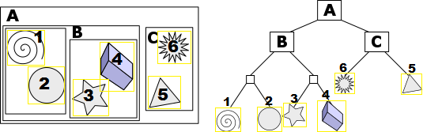
Part A: BVH Tree
Construction:
- Group objects in tight bounding volumes (leaf node)
- Group nodes into larger bound volumes
- Build hierarchy of bounding volumes in a recursive fashion
Traversal:
[https://en.wikipedia.org/wiki/Bounding_volume_hierarchy]
Notes:
All volumes are axis- aligned

Slide 3
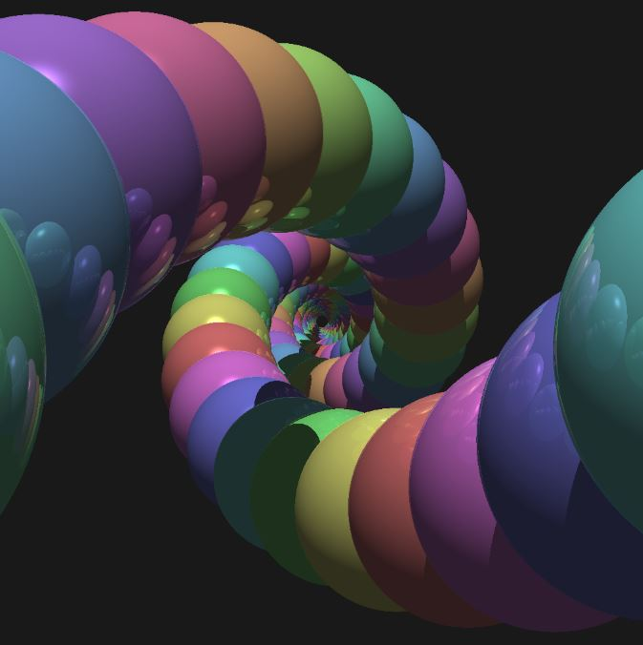
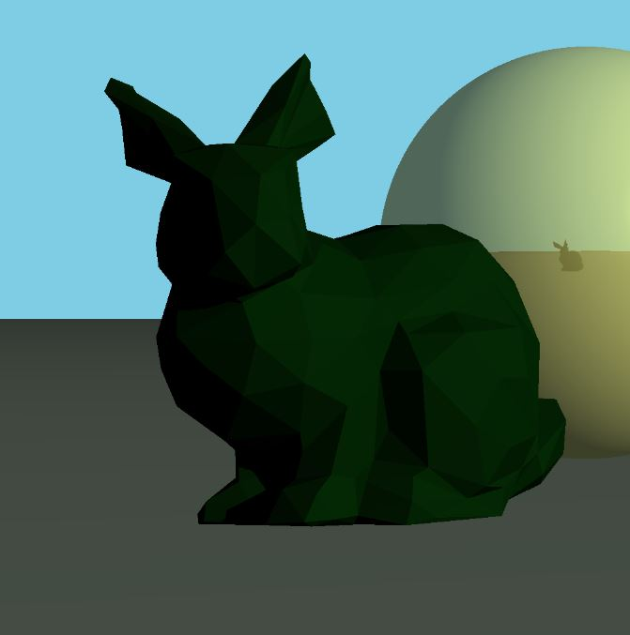
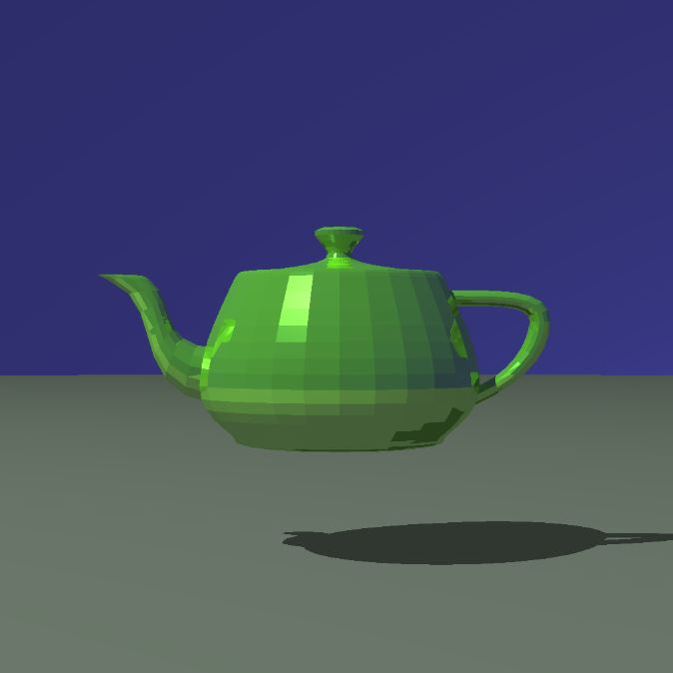
Part A: BVH Tree
Experiments:
Teapot (3K Triangles)
▪ BVH →4.08 Sec
▪ No BVH → 476 Sec
Spiral (260 Spheres)
▪ BVH →1.71 Sec
▪ No BVH → 34.7 Sec
Bunny (500 Triangles)
▪ BVH →1.32 Sec
▪ No BVH → 43 Sec

Slide 4
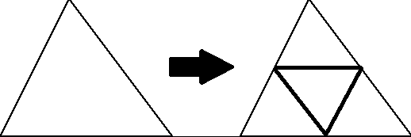
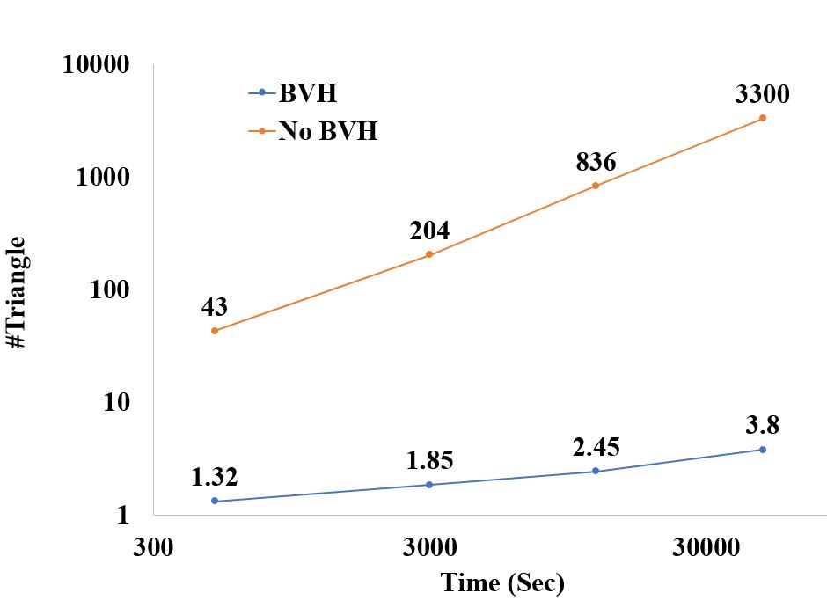
Part A: BVH Tree
Experiments:
-Dividing each triangle into four triangles
-Testing the performance with and without BVH

Slide 5
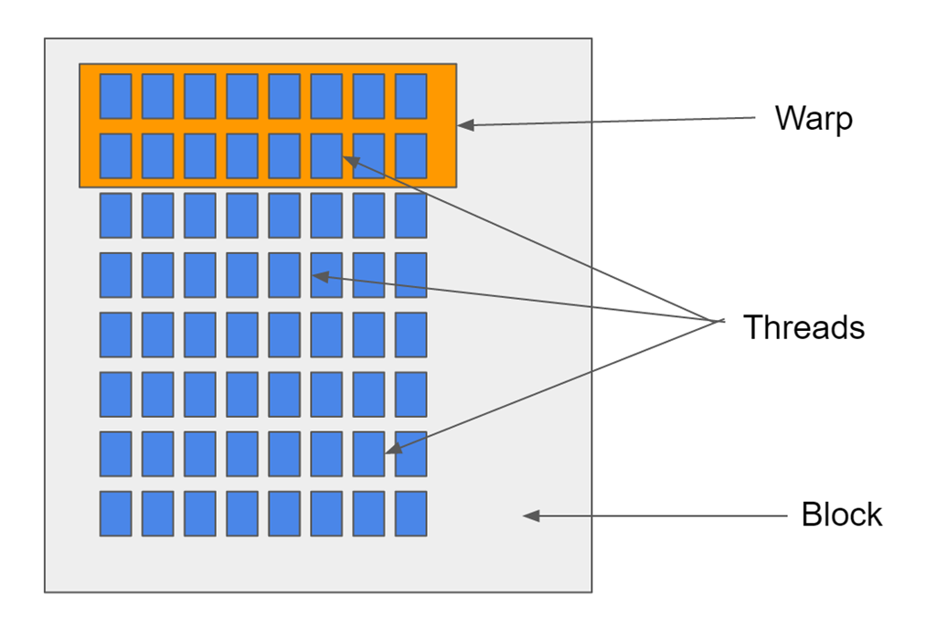
Part B: Path Tracing using CUDA
Big Picture:
- Divide the computation into multiple threads of execution
- Write the code for a thread such that each thread will run serially
- All thread run in parallel
- Care must be taken to avoid thread divergence and memory accesses
[http://blog.marcgravell.com/2016/05/how-i-found-cuda-or-rewriting-tag_9.html]
Notes:
All volumes are axis- aligned

Slide 6
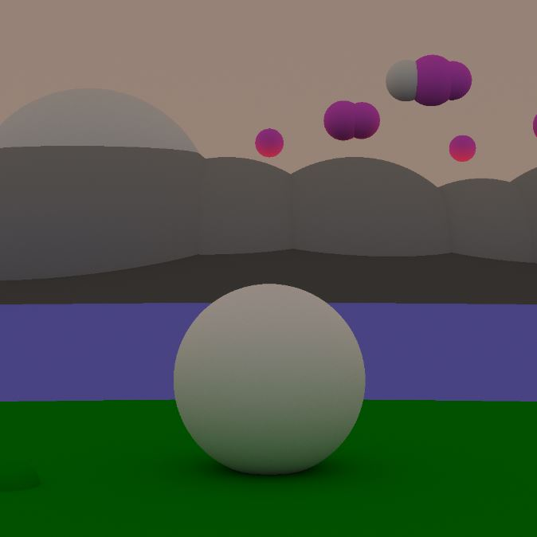

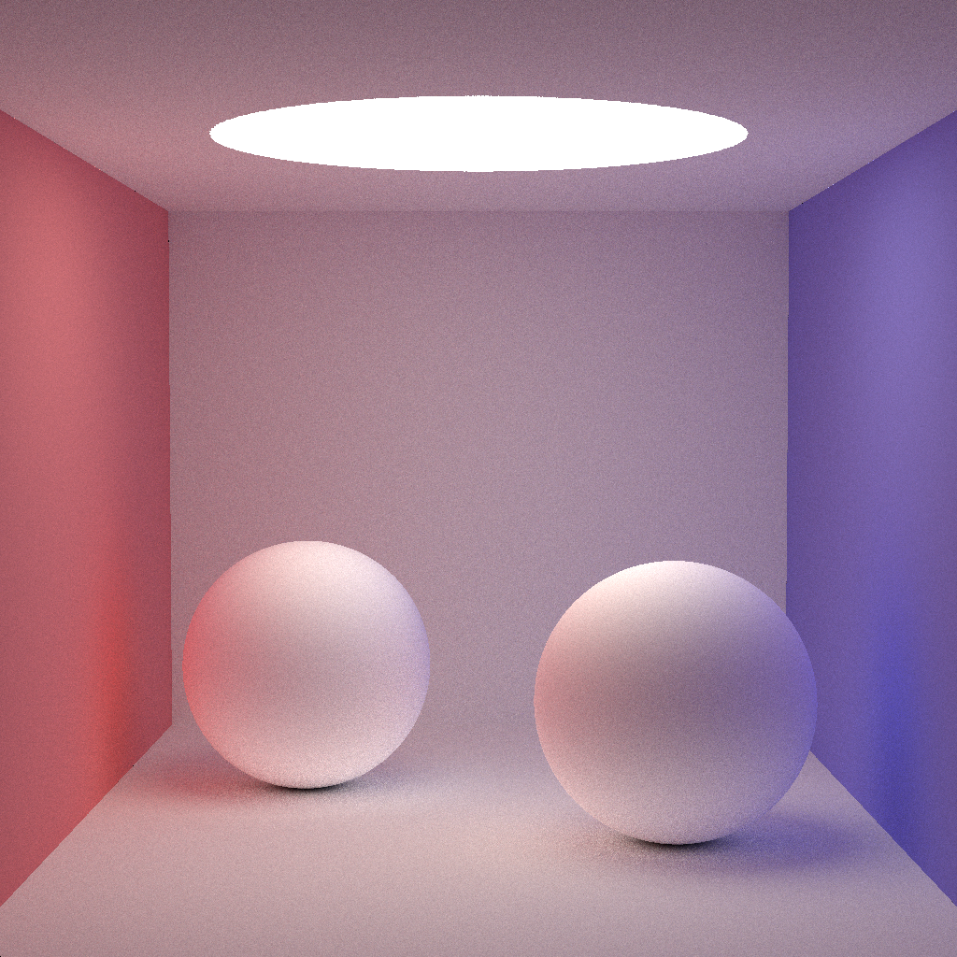
Part A: Path Tracing using CUDA
Experiments:
Cornell Box (9 Spheres)
1.489 Sec
Vista (12 Spheres)
2.283 Sec
Night Sky (12 Spheres)
1.4209 Sec
Notes:
All volumes are axis- aligned

